Slide 1




Slide 2
Agenda
Work Culture at AECI
Activity
Open forum

Slide 3
What is AECI?

Slide 4
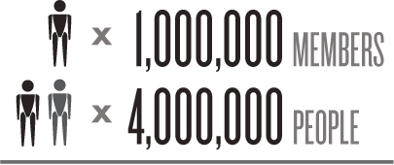
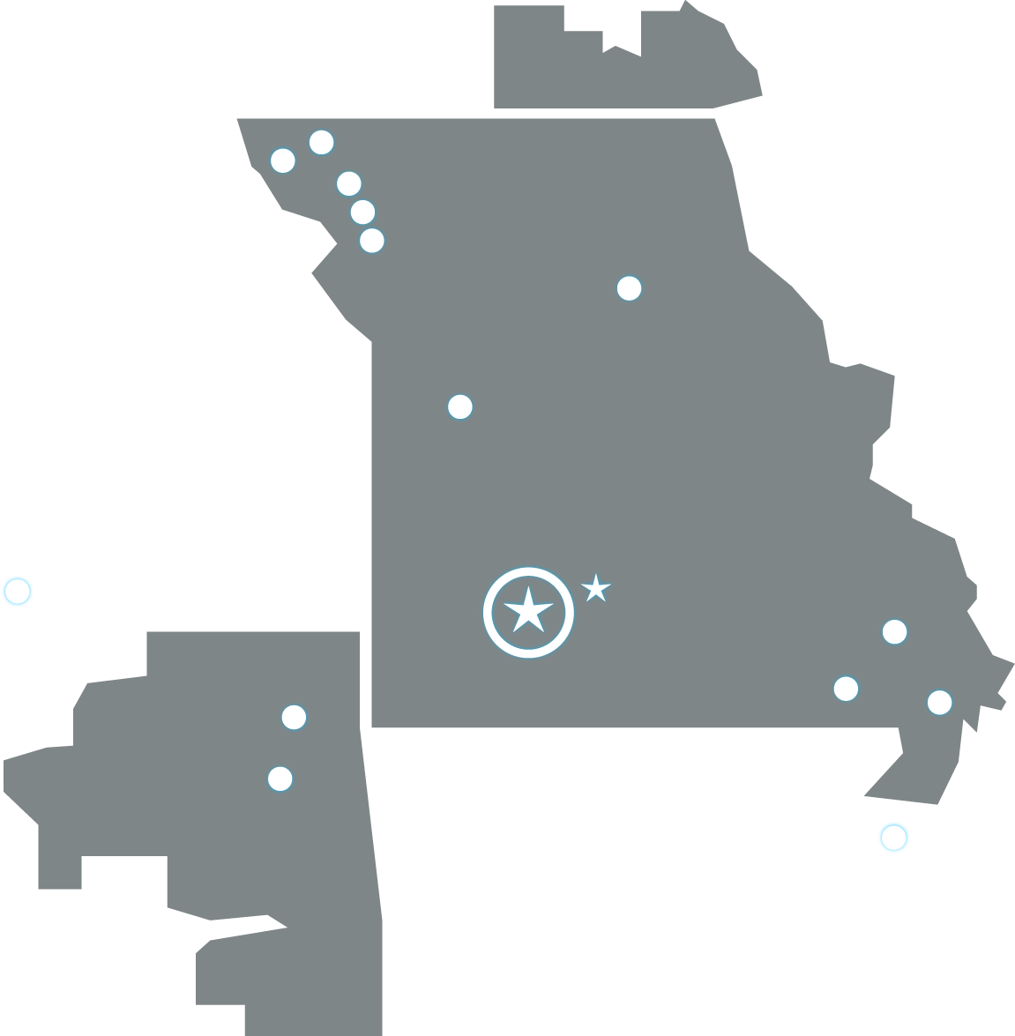
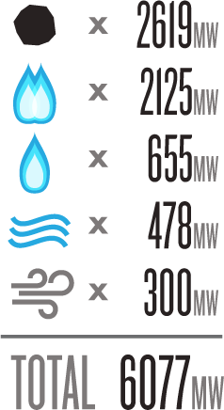
Notes:
Associated Electric
Based in Springfield Missouri [click to annimate], serving one million members or 4 million people in Missouri, Southern Iowa and North Eastern Oklahoma
Own or Operate 2 Coal Fire Generating Stations, 3 Combined Cycle natural gas Plants, 4 simple cycle gas/oil plants.
Hydro Electric power from SPA, 5 wind farms

Slide 5
Culture
What is it like to work at AECI

Slide 6
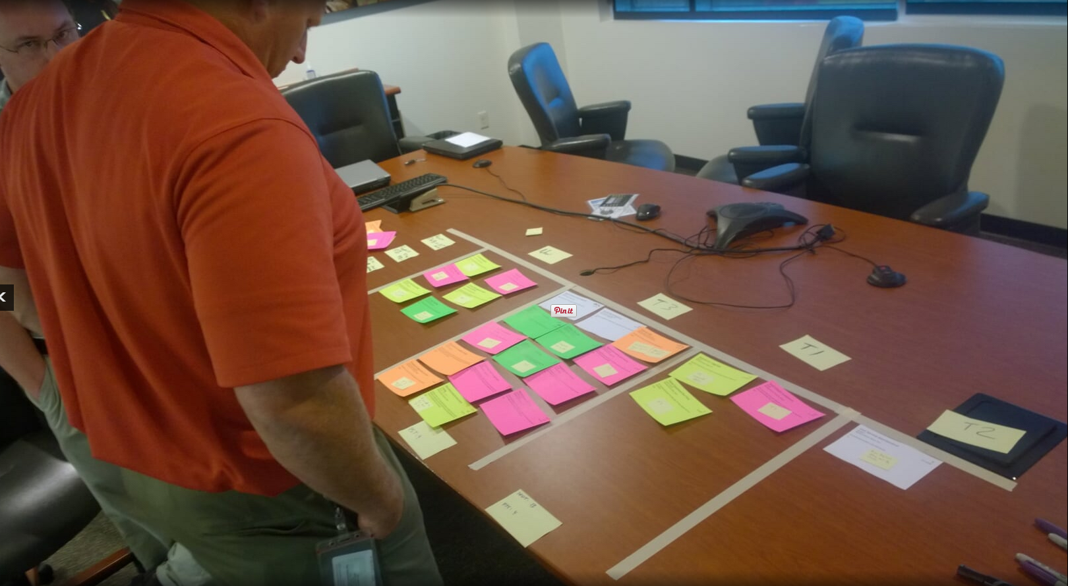
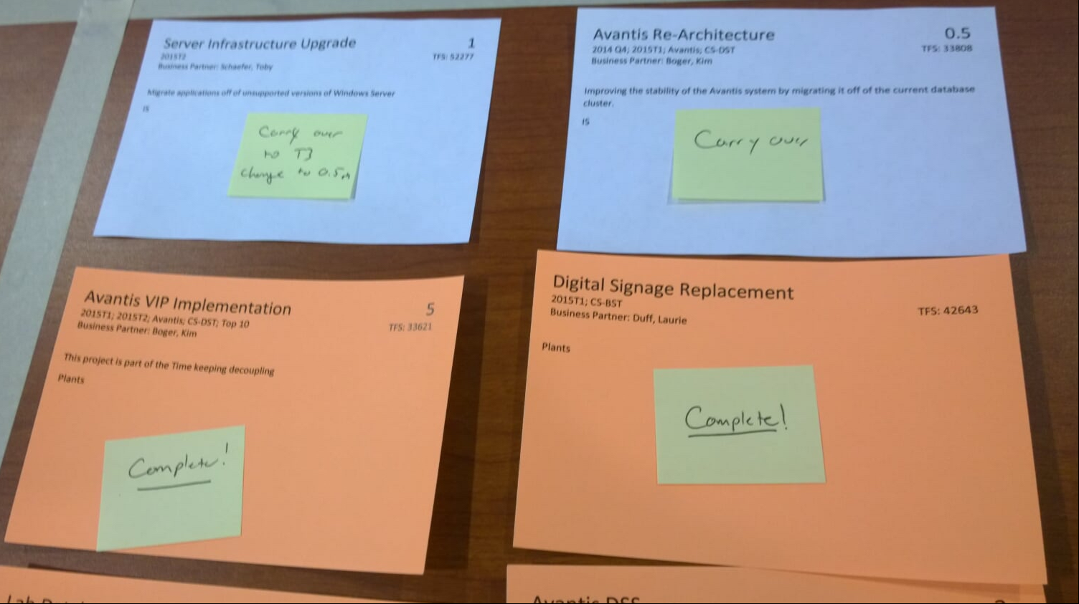
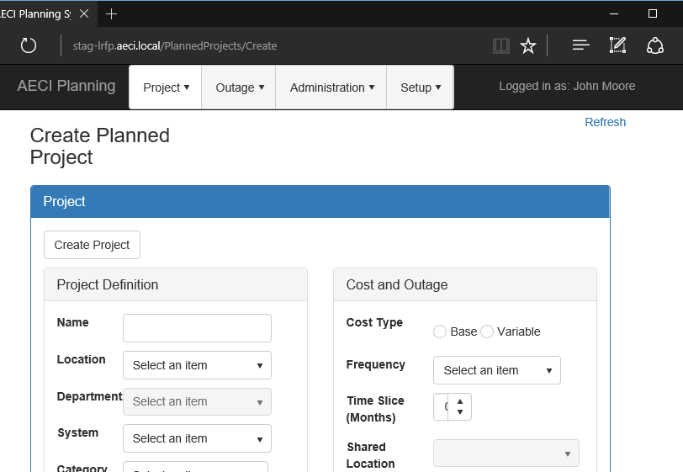
Create

Slide 7
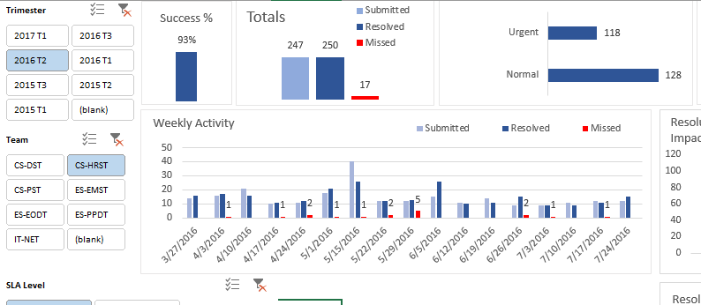
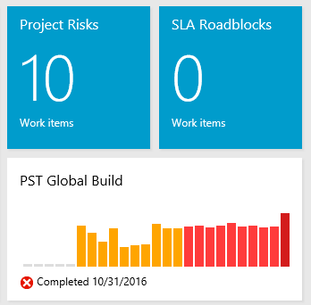
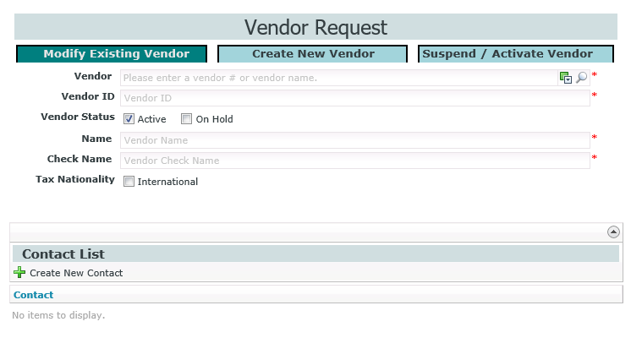
Craftsmanship

Slide 8
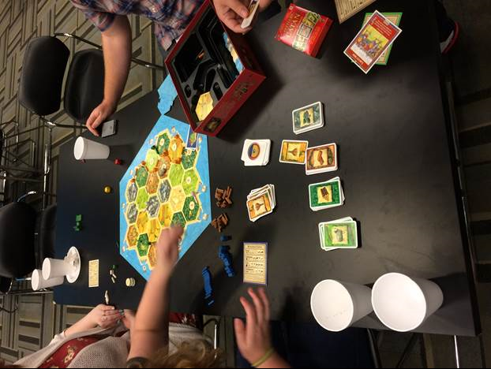
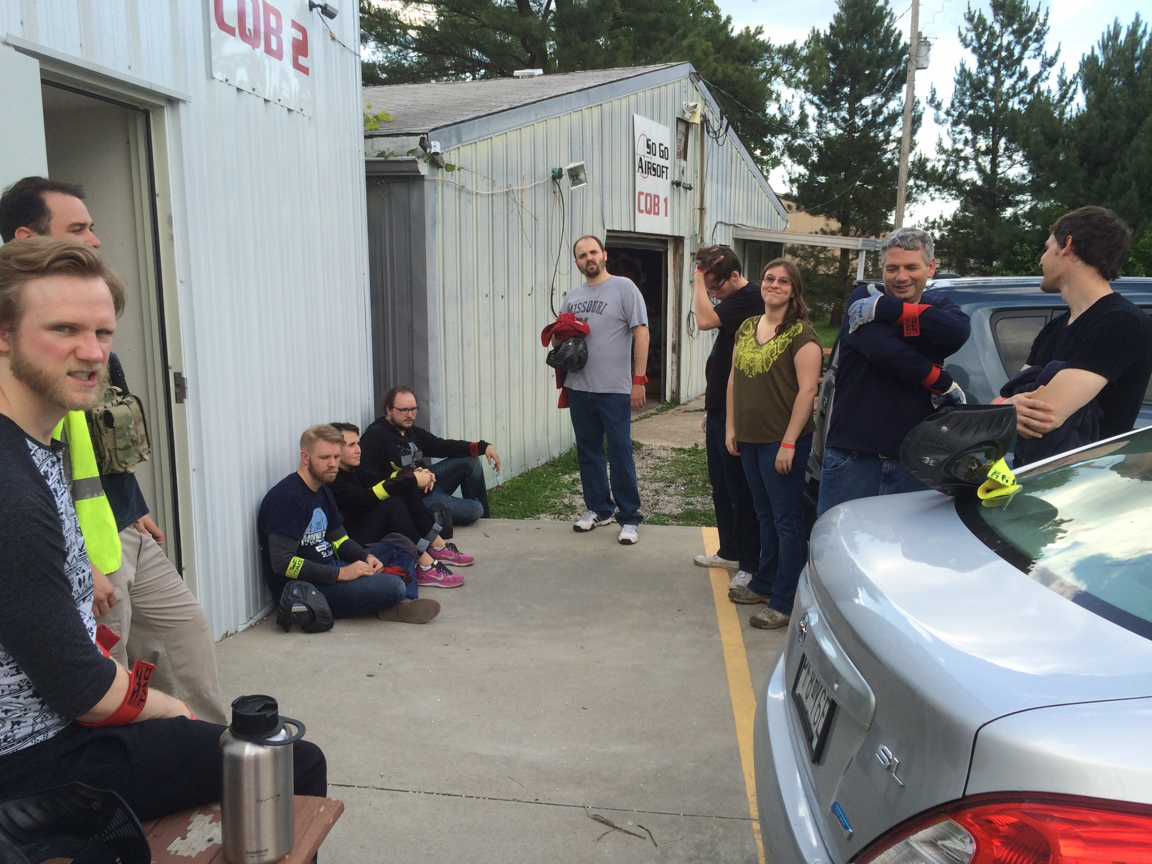
Community

Slide 9

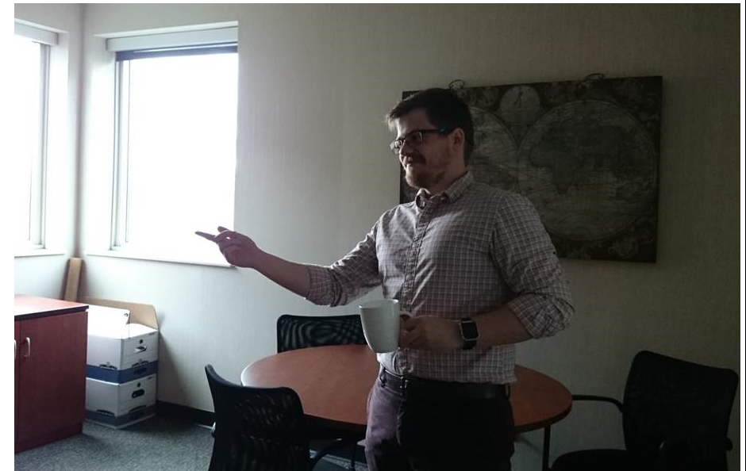
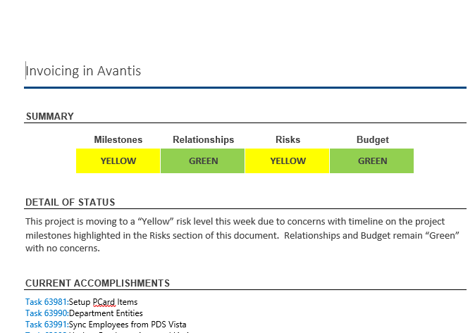
Communication

Slide 10
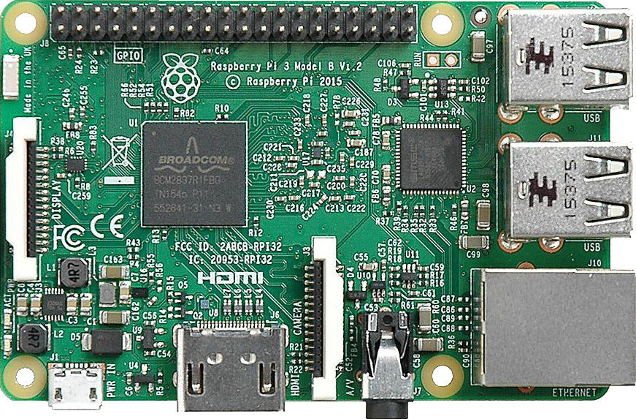
Change

Slide 11
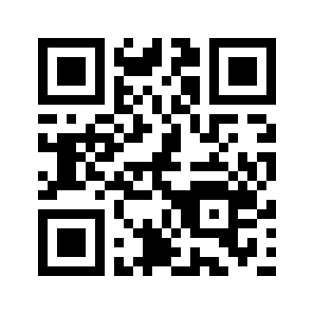
Community – http://bit.ly/2ejaw8x
Get into groups of 4
Number your selves 1-4
Number 1: go the this web site
Number 2: come up and get supplies

Slide 12
Open Forum

